Slide 1

Social Media AD Campaign Optimization
By Omkar K

Slide 2
Overview:
Objective: To optimize advertising performance through a detailed analysis of campaign data.
Methodology: Utilization of SQL for data querying and Power BI for advanced visualization.
Expected Outcome: Actionable insights and strategic recommendations aimed at enhancing Return on Ad Spend (ROAS).

Slide 3
Problem Statement
Challenge: Suboptimal allocation of advertising budgets across platforms and demographic segments, leading to inefficiencies.
Objective: To identify the highest-performing platforms, advertising formats, and audience segments to maximize ROAS and streamline ad expenditures.

Slide 4
Data Overview
Dataset Description:
Data encompasses metrics such as Click-Through Rate (CTR), conversions, Return On Ad Spend(ROAS) , and advertising expenditure.
Platforms Covered: Facebook, Instagram, and Twitter.
Key Attributes:
Demographic data: Age group, gender.
Ad performance metrics: Conversions, CTR, and ROAS.

Slide 5
Methodological Framework
Data was systematically extracted and processed using SQL queries.
Insights were visualized through Power BI dashboards to identify key patterns and trends.
Results were synthesized into actionable recommendations to optimize campaign performance.

Slide 6
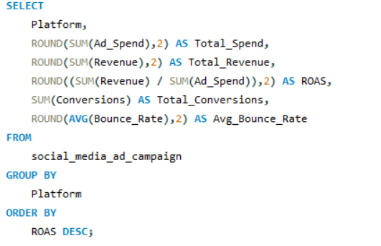
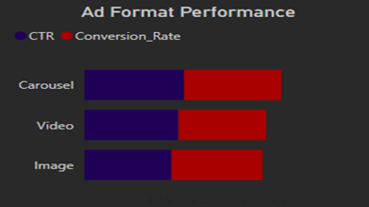
Platform Performance Analysis
SQL Query:
Visualization:
Bar Chart: Total conversions by platform, with ROAS as a secondary metric overlay.

Slide 7
Key Insights:
Instagram exhibits the highest ROAS at 3.72.
Facebook achieves the greatest number of conversions but marginally lower ROAS.
Twitter has the lowest ROAS (2.91), highlighting potential inefficiencies.
Strategic Recommendations:
Amplify budget allocation to Instagram campaigns to capitalize on its superior ROAS.
Revise and optimize Twitter advertising strategies to enhance performance.

Slide 8
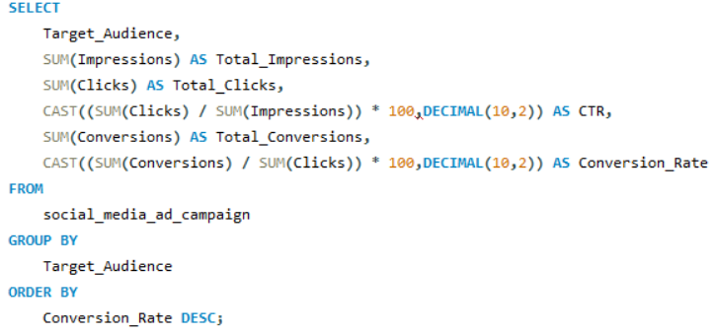
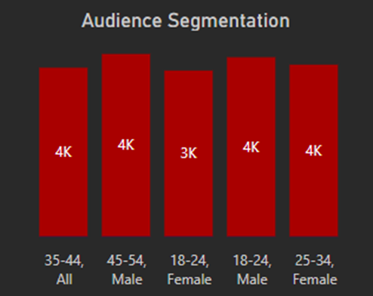
Audience Segmentation Analysis
SQL Query:
Visualization:
Clustered Bar Chart: Breakdown of conversions by age group and gender.

Slide 9
Key Insights:
Males aged 18-24 demonstrate the highest conversion rates, with 4,200 conversions.
Females aged 25-34 and the all-gender 35-44 group are also significant contributors.
Strategic Recommendations:
Target males aged 18-24 with tailored advertising content to sustain high conversion rates.
2. Design customized campaigns for females aged 25-34 to further optimize . engagement.

Slide 10
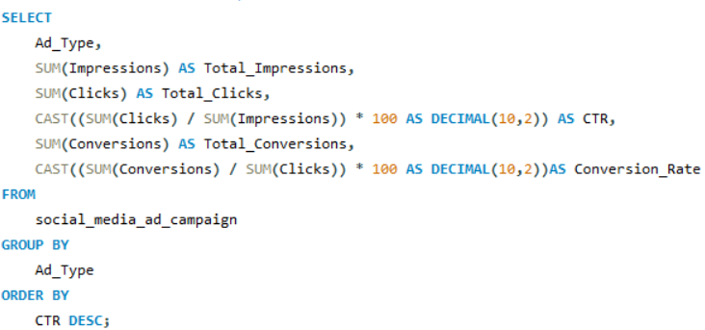
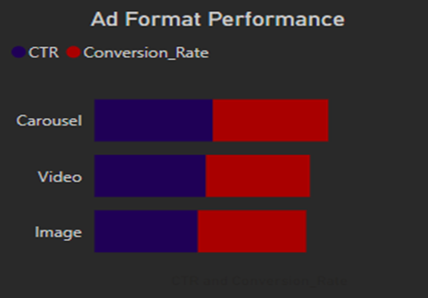
Visualization:
Bar Chart: Comparison of average CTR and conversion rate by ad format.
Ad Format Performance
SQL Query:

Slide 11
Key Insights:
Carousel ads achieve the highest CTR and conversion rates, surpassing video and image formats.
Image ads underperform relative to both video and carousel formats.
Strategic Recommendations:
Prioritize carousel ads in future campaigns for optimal engagement and conversions.
Reassess and enhance image ad content to improve performance.

Slide 12
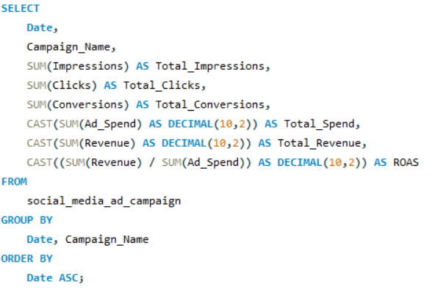
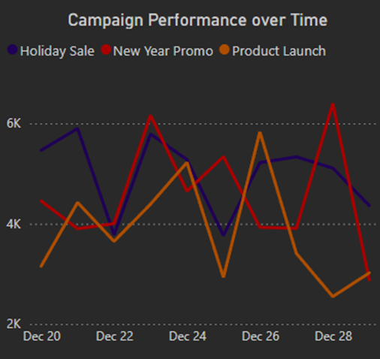
Campaign Performance Over Time
SQL Query:
Visualization:
Line Chart: Temporal trends in ROAS and ad spend.

Slide 13
Key Insights:
Holiday sales campaigns exhibit the highest ROAS peaks, indicating high ROI periods.
New Year promotional campaigns incur higher expenditures with comparatively lower ROAS.
Strategic Recommendations:
Reallocate budget to prioritize holiday season campaigns.
Reevaluate the effectiveness of New Year campaigns to improve their return.

Slide 14
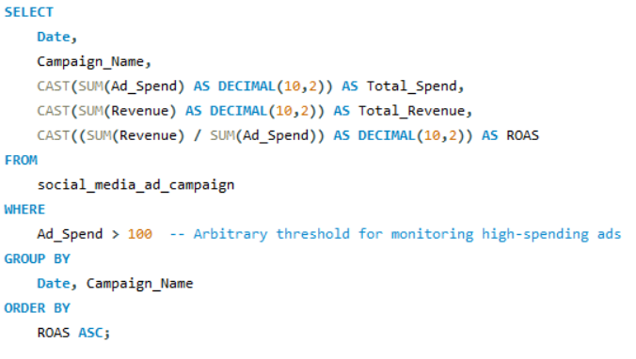
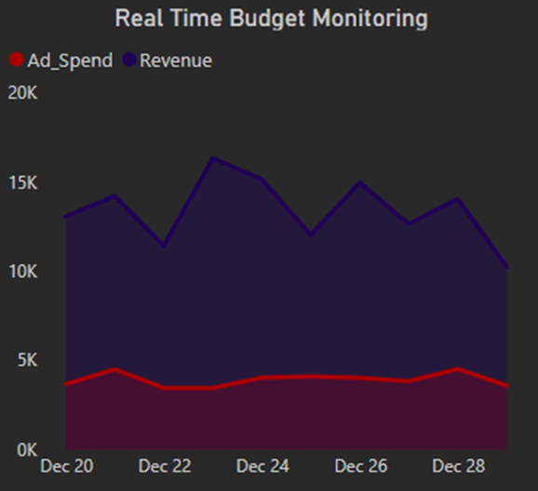
Real-Time Budget Monitoring
SQL Query:
Visualization:
Area Chart: Daily ad spend juxtaposed against revenue trends.

Slide 15
Key Insights:
Revenue surges are evident on December 24th and 26th, indicating key sales periods.
Daily ad spend remains steady, yet ROAS fluctuates significantly.
Strategic Recommendations:
Employ dynamic budget monitoring to maximize ROI during high-revenue periods.
Focus on optimizing campaigns on identified peak days for maximum impact.

Slide 16
Summary of Insights and Recommendations
Key Insights:
Instagram leads in ROAS, whereas Facebook dominates in conversions.
Carousel ads outperform other formats in both CTR and conversion rates.
Males aged 18-24 and females aged 25-34 are the most responsive demographic segments.
Strategic Recommendations:
Allocate increased budgets to Instagram campaigns and carousel ad formats.
Develop highly personalized campaigns for top-performing audience segments.
Continuously optimize underperforming campaigns to improve cost-effectiveness.

Slide 17
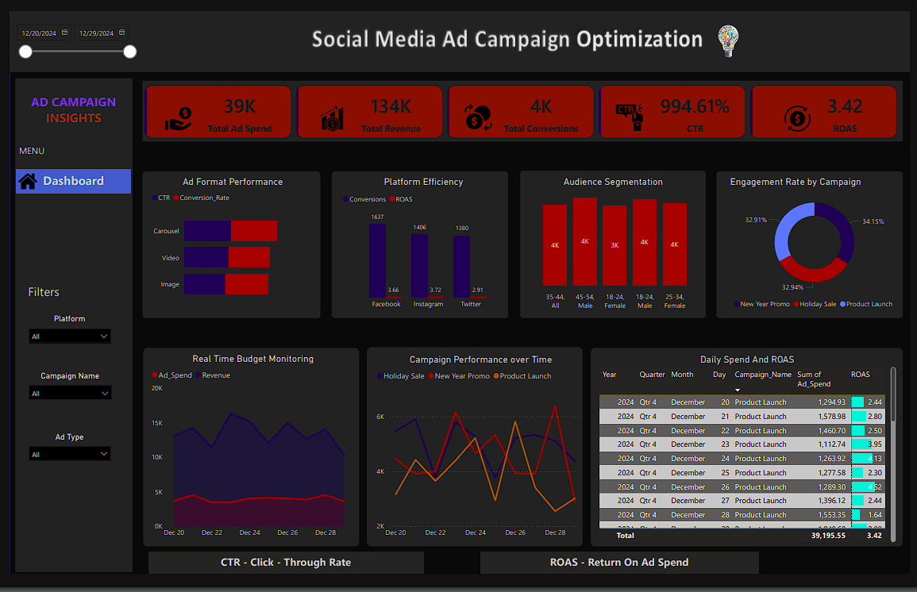
Power BI Dashboard

